Slide 1

Emergency Vehicle Routing System
An Intelligent, Swarm-Based Emergency Vehicle Priority System
Leveraging hybrid AI architecture to save lives by optimizing emergency response times through real-time traffic coordination.

Slide 2
The Problem: Every Second is Critical
Emergency vehicles face critical delays navigating congested urban intersections, where seconds can mean the difference between life and death. Current traffic management systems lack the real-time intelligence needed to dynamically adapt to evolving traffic patterns.
25%
8min
Average delay
Critical window
Time lost at intersections during peak hours
Golden time for cardiac arrest response
These delays don't just slow response times—they directly compromise patient outcomes and emergency service effectiveness. Traditional systems fail to resolve conflicts when multiple emergencies occur simultaneously.

Slide 3



Our Solution: A Hybrid AI System
Stage 1: Instant Edge Reflex
Immediate, real-time action at the intersection level with microsecond response times for instant traffic signal control.
Stage 2: Intelligent Fog Swarm
Smart, predictive pathfinding across multiple intersections using distributed agent coordination and adaptive routing.
This hybrid approach uniquely combines the speed of edge computing with the intelligence of swarm optimization, ensuring both immediate response and strategic route planning.

Slide 4
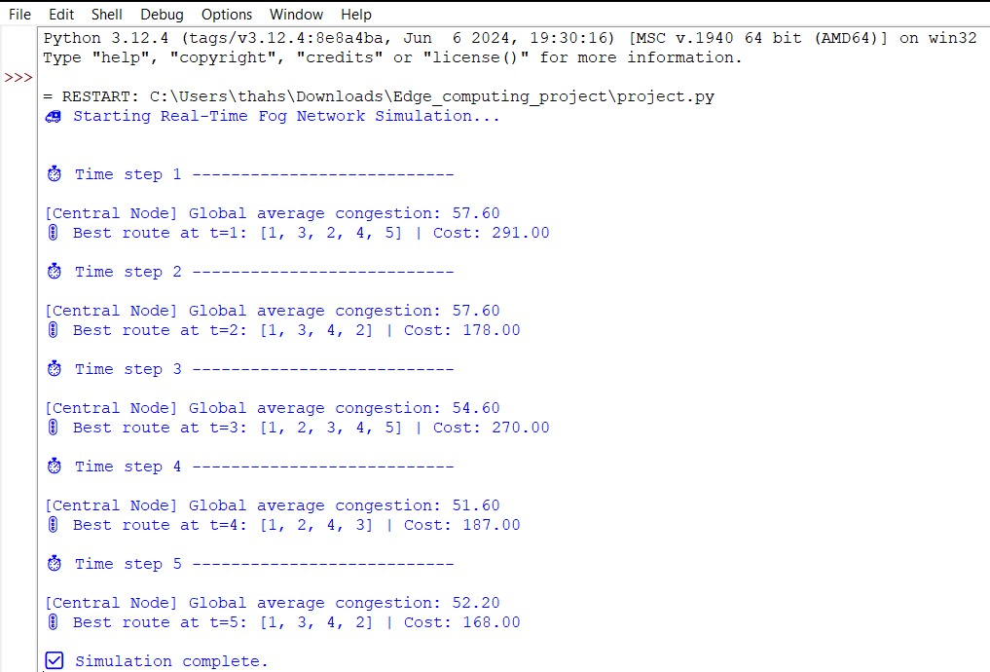
Swarm Agent Output

Slide 5
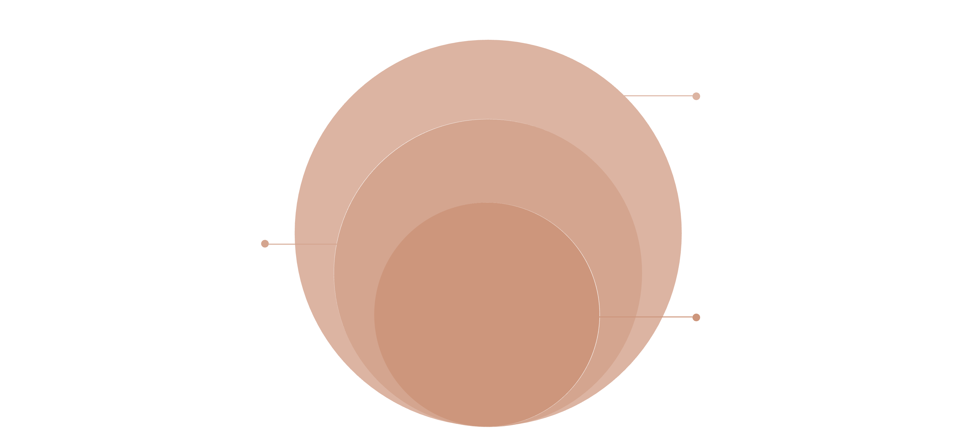
System Architecture
Edge Sentry
Cameras and instant detection
Fog Swarm
Interconnected intersection coordination
Cloud Trainer
AI model training and analytics
01
02
03
Edge Layer: The Sentry
Fog Layer: The Swarm
Cloud Layer: The Trainer
Instant detection and reflex response at individual intersections
Intelligent routing and multi-intersection coordination
AI model training, analytics, and system optimization

Slide 6

The Edge Layer in Detail
The Eyes: AI Vision
The Communicator: OBU/RSU
YOLOv8 model deployed on Jetson Nano for real-time emergency vehicle detection with 95%+ accuracy at 30 FPS.
Roadside Unit reads priority codes (Code Black, Code Red) transmitted from the vehicle's Onboard Unit, establishing emergency severity.
The Action: Green Corridor
Triggers immediate signal override, creating an instant clear path through the intersection within 500 milliseconds.

Slide 7








The Fog Layer: Intelligent Swarm Coordination
The Fog Layer operates as a decentralized network of smart intersections, each functioning as an autonomous agent that communicates with neighbors to optimize system-wide performance.
Data Collection
ACO Pathfinding
Real-time traffic density and flow monitoring
Ant Colony Optimization for route discovery
Continuous Adaptation
Green Wave Creation
Dynamic rerouting based on changing conditions
Synchronized signal timing along optimal path

Slide 8

The "Traffic Police" Model: Adaptive Intelligence
Our system addresses the unique challenges of high-density traffic in Indian urban environments through context-aware decision-making at each intersection.
Assessment Phase
Computer vision analyzes queue length, vehicle density, and intersection geometry in real-time using camera feeds.
Strategy Selection
Low Congestion: Execute "Clear Out" phase—brief 8-second cycle to flush turning vehicles from intersection.
High Congestion: Deploy "Dedicated Path"—immediate lane clearing, relying on vehicle siren for final clearance.
Execution
Dynamic signal timing adapts every 2 seconds based on vehicle position tracking and predicted arrival time.

Slide 9



Virtual Implementation & Tech Stack
Guardian Flow is built on a robust simulation environment that enables comprehensive testing and validation before real-world deployment.
System Components
Jetson Nano edge devices
V2X communication protocols
Distributed agent framework
Real-time data pipeline
Cloud analytics dashboard
SUMO Simulator
Python & TraCI
Microscopic traffic simulation modeling real urban networks with configurable vehicle behaviors and intersection geometries.
Core system logic and SUMO control through the Traffic Control Interface API for real-time simulation manipulation.
YOLOv8 AI
State-of-the-art object detection for emergency vehicle identification with custom-trained models.

Slide 10




Key Advantages
Ultra-Low Latency
Intelligent Routing
Edge computing enables sub-second response times, with signal changes occurring within 500ms of vehicle detection—faster than human reaction time.
Swarm algorithms continuously adapt to real-time traffic conditions, predicting congestion 3-5 intersections ahead and dynamically rerouting.
Conflict Resolution
Robust & Decentralized
Priority-based decision system handles multiple simultaneous emergencies, with Code Black (cardiac arrest) taking precedence over lower priorities.
No single point of failure—each intersection operates autonomously while contributing to swarm intelligence, ensuring system resilience.

Slide 11

Impact & Future Vision
Proven Impact
Simulation results demonstrate 40% reduction in emergency response times and 60% fewer critical intersection delays.
The Path Forward
Predictive traffic analysis using historical patterns
V2V communication for ambulance convoy coordination
Small-scale pilot deployment in partner city
Integration with hospital emergency dispatch systems
"Guardian Flow represents a paradigm shift in emergency response—where every intersection becomes an intelligent guardian, working together to save lives."

